Slide 1

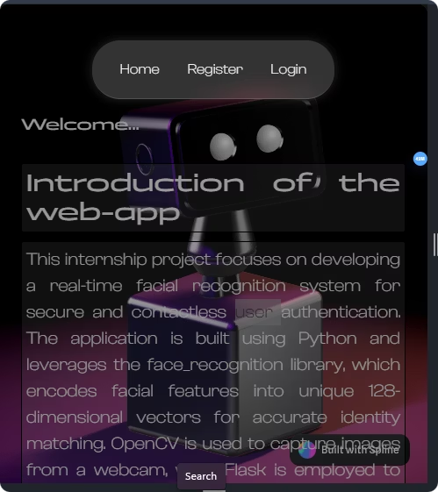
Cybersecurity-Based Login Monitoring and Task Management System
This presentation outlines a comprehensive system that integrates secure login monitoring with an efficient task management platform. Designed to strengthen cybersecurity measures while streamlining user and administrative workflows, the system addresses modern organizational needs for security and accountability.

Slide 2
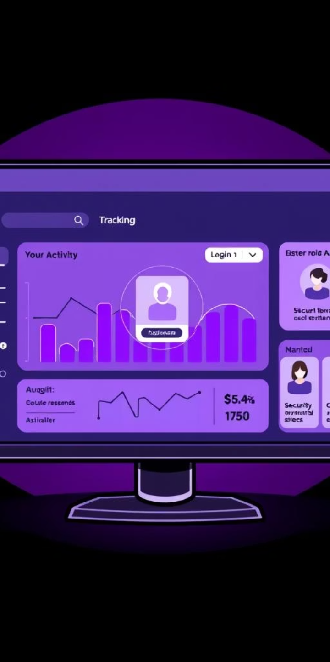



Introduction to the System
Unified Login Activity Tracking
Secure Dashboards
Provides role-based interfaces for admins and users, enabling visibility into login patterns and task management for productivity and security.
Monitors and records login events with detailed timestamps to build complete login histories for all users.
Enhanced Security Protocols
Detects suspicious activity proactively to safeguard against unauthorized access and insider threats.

Slide 3

Identified Problems in Existing Systems
Attendance Without Security
Lack of Suspicious Activity Detection
Current attendance systems often track presence but overlook login security and behavioral monitoring.
No mechanisms to detect repeated failed logins or access from unusual times and locations, increasing vulnerability.
Absence of Centralized Task Management
Accountability Deficit
Without integrated logging and dashboards, tracing user actions and ensuring responsibility is difficult.
Separate tools or manual methods hinder efficient task allocation and oversight by administrators.

Slide 4
System Objectives
Comprehensive Login Monitoring
Dynamic Role-Based Dashboards
Robust Security Implementations
Record all login events with timestamps accurately
Admins assign tasks and review consolidated login logs
Log failed login attempts for anomaly detection
Calculate daily attendance automatically from login data
Users view personal login histories and pending tasks
Prevent unauthorized access with layered validations

Slide 5





Technology Stack Overview
Backend: Python (Flask)
Handles API requests, session management, and security validation logic with scalable architecture.
Database: MySQL
Stores detailed login histories, attendance records, and task information securely with integrity.
Frontend: React / JavaScript
Delivers responsive, intuitive dashboards for both administrators and users, supporting rich interactions.
Security Layer
Tracks IP addresses, failed attempts, and suspicious access patterns to enforce security policies.

Slide 6





Methodology and Workflow
User Login Events
All user login activities are recorded in the login_history table with precise timestamps.
Attendance Calculation
A scheduled query aggregates distinct login dates automatically, updating the attendance records accurately.
Admin Task Assignment
The admin dashboard presents user summaries and allows task creation, modification, and deletion.
User Dashboard Access
Users can conveniently view their attendance, login history, and assigned tasks to stay informed and productive.
Security Monitoring Scripts
Automated checks detect suspicious login attempts and failed logins to prevent security breaches.

Slide 7





Advanced Cybersecurity Features
Failed Login Tracking
Continuous monitoring of failed login attempts helps detect brute-force and credential-stuffing attacks.
Suspicious Login Detection
Identifies anomalies related to login timing, IP addresses, and geographic inconsistencies to flag potential threats.
Audit Trails & IP Logging
Comprehensive logs maintain compliance requirements and traceability for forensic analysis and reporting.
Role-Based Access Control
Strict access permissions ensure that only authorized administrators can perform sensitive functions like task assignment.

Slide 8
Dashboard and Future Expansion
Dashboard Overview
Future Enhancements
The Admin Dashboard facilitates detailed user monitoring and task management with intuitive controls for task assignment, editing, and deletion.
Integrate Two-Factor Authentication (2FA) for enhanced access security.
Implement AI-driven anomaly detection for real-time threat analysis.
The User Dashboard provides personalized access to login records, attendance status, and task lists, supporting user empowerment.
Enable real-time notification systems for security alerts and task updates.
Explore biometric login integration for robust user verification.

Slide 9
Integrating Essential Security Techniques
Two-Factor Authentication (2FA): Adds a second verification step to enhance login security.
AI-Driven Anomaly Detection: Uses machine learning to identify suspicious behaviors in real time.
Real-Time Notifications: Alerts users and admins instantly about critical security events.
Biometric Authentication: Supports fingerprint or facial recognition for strong user verification.
Role-Based Access Control (RBAC): Ensures users have appropriate permissions to protect sensitive data.

